Slide 1

Problem: n friends (variations)
Odd number of students

Slide 2
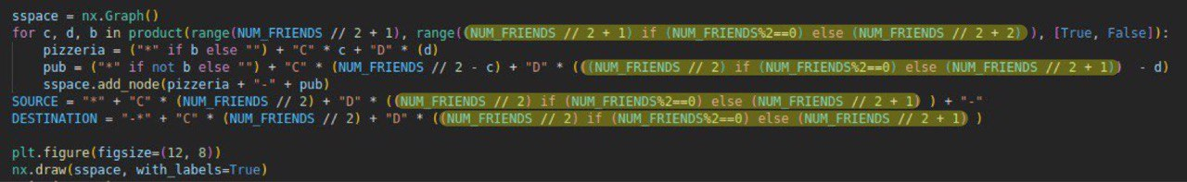
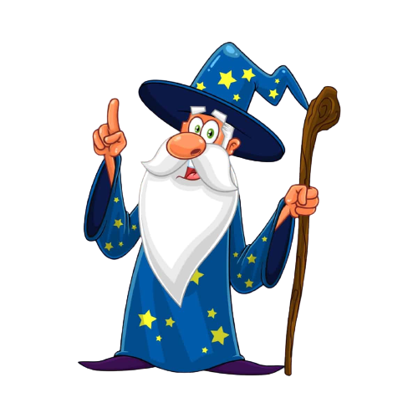
Little tricks to adapt the code

Slide 3
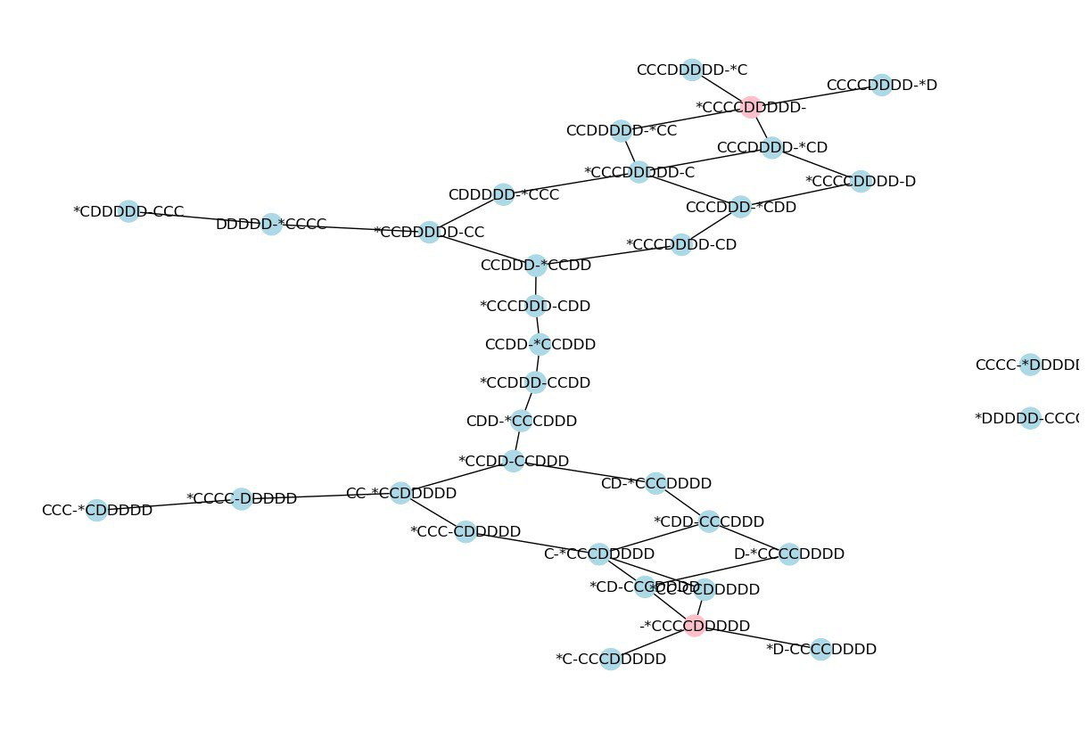

9 friends problem has a solution while there is no solution with 8 friends

Slide 4
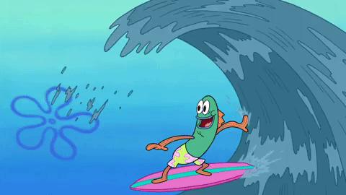
Surfing the wave of excitement
Let’s try with 51 friends!!!

Slide 5
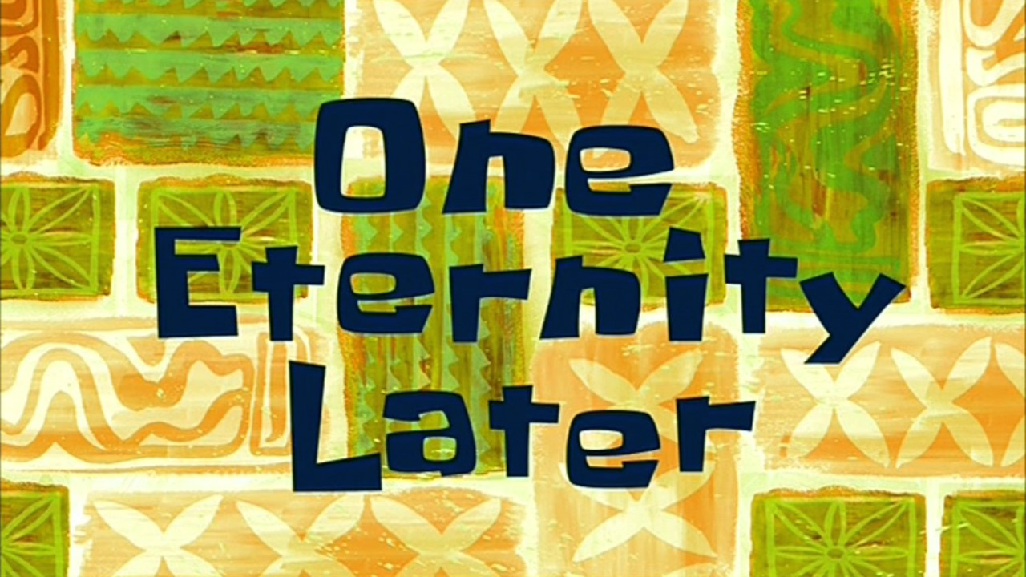

Slide 6
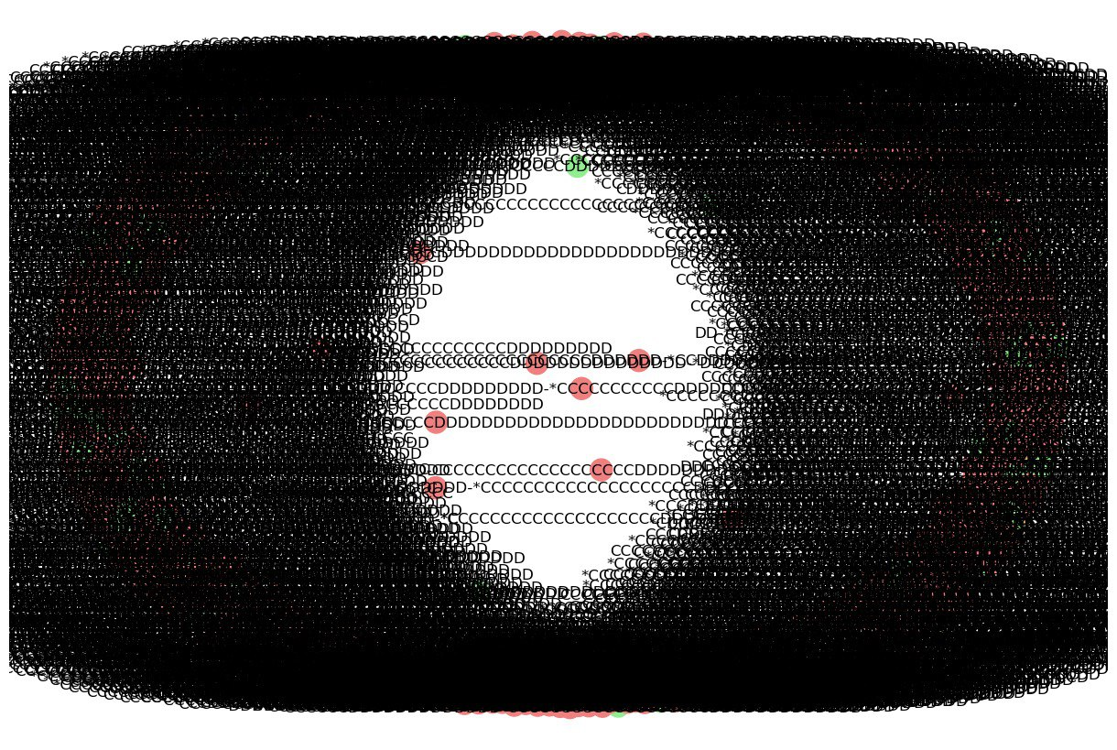

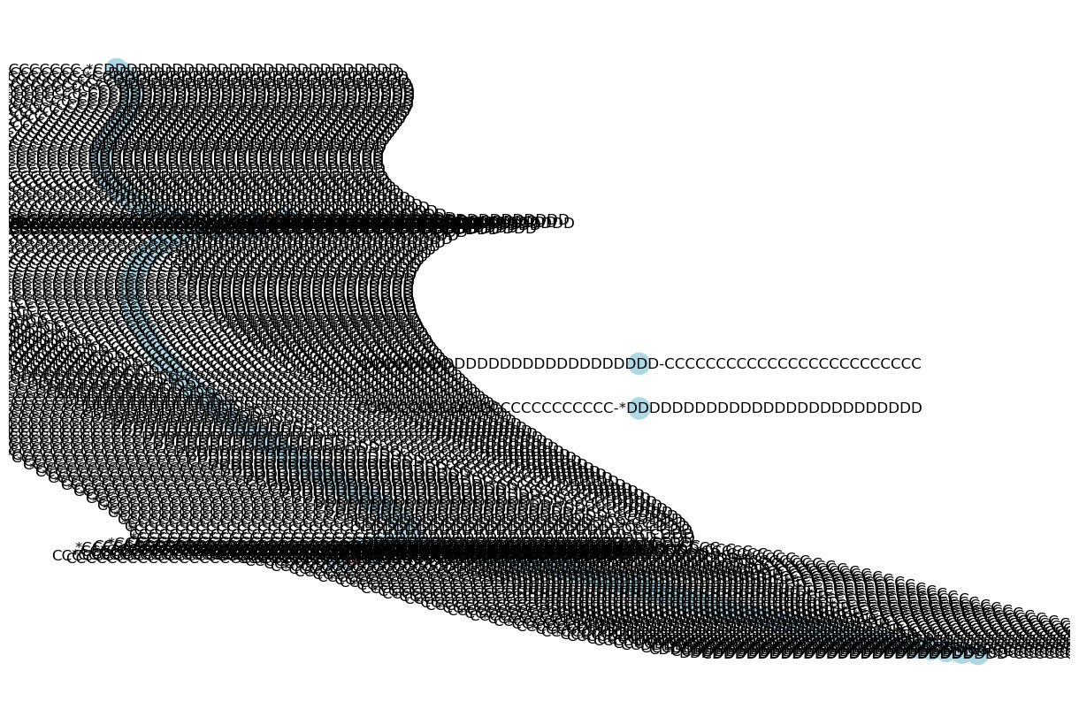
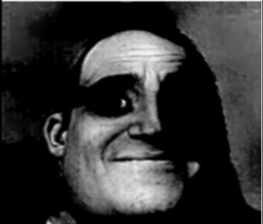

Slide 7
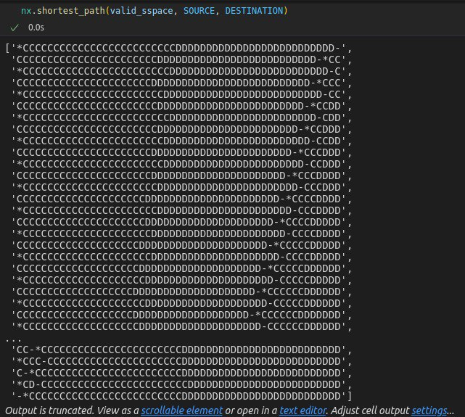
But…there is a solution!

Slide 8
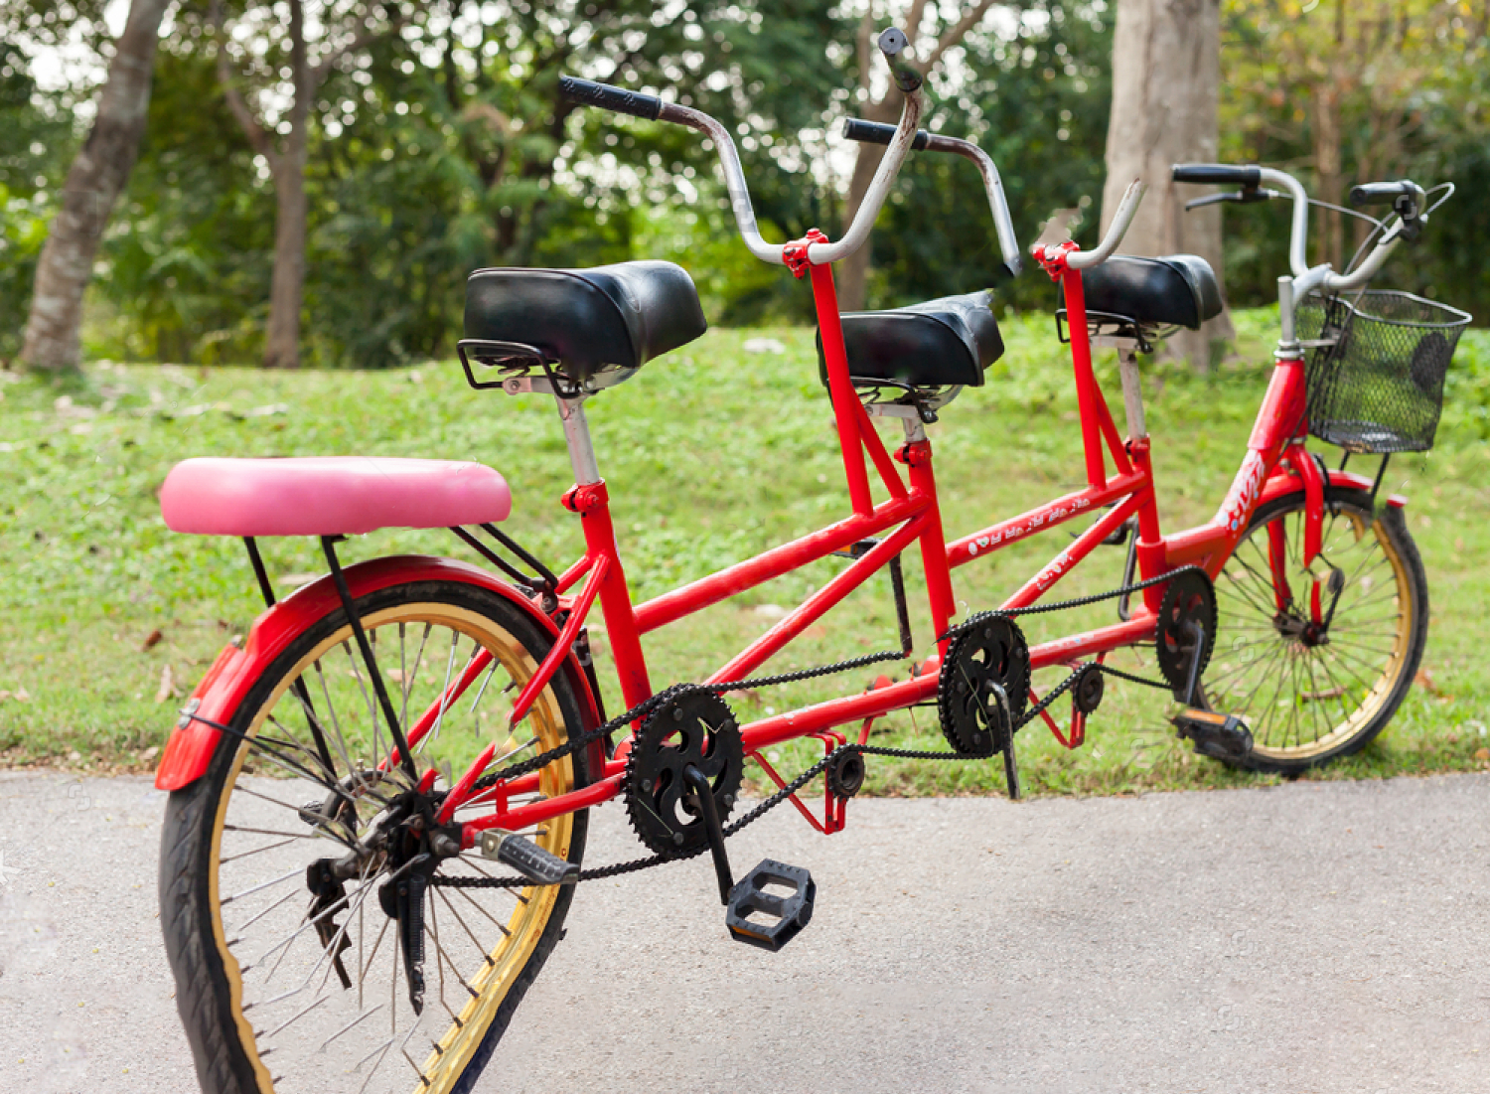
What if the bike has more than 2 seats?
Trying the original problem with 3 seats bike

Slide 9
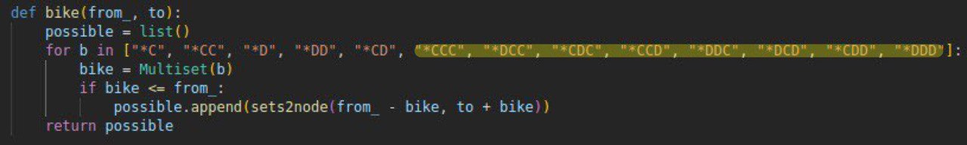
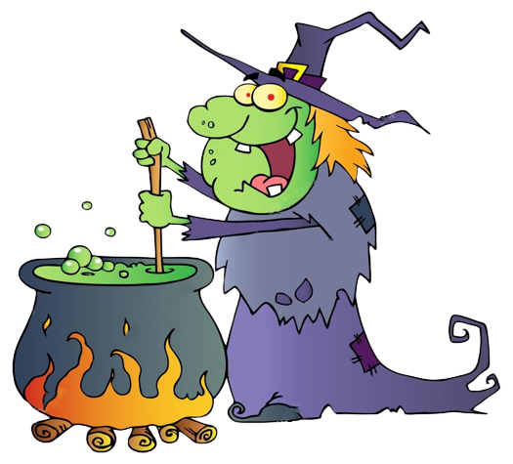
Some more tricks

Slide 10
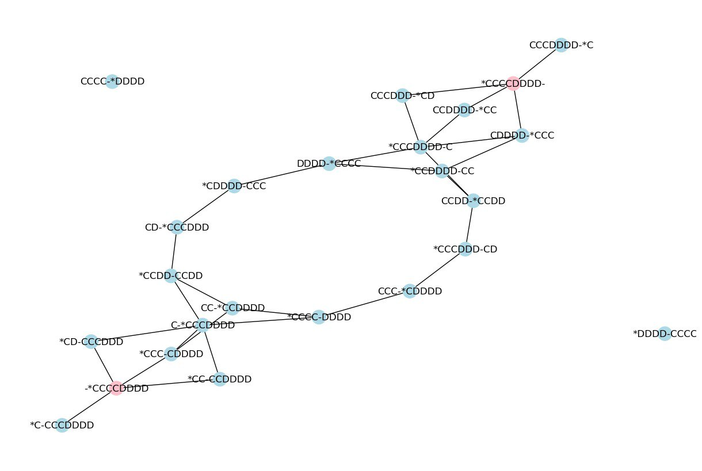
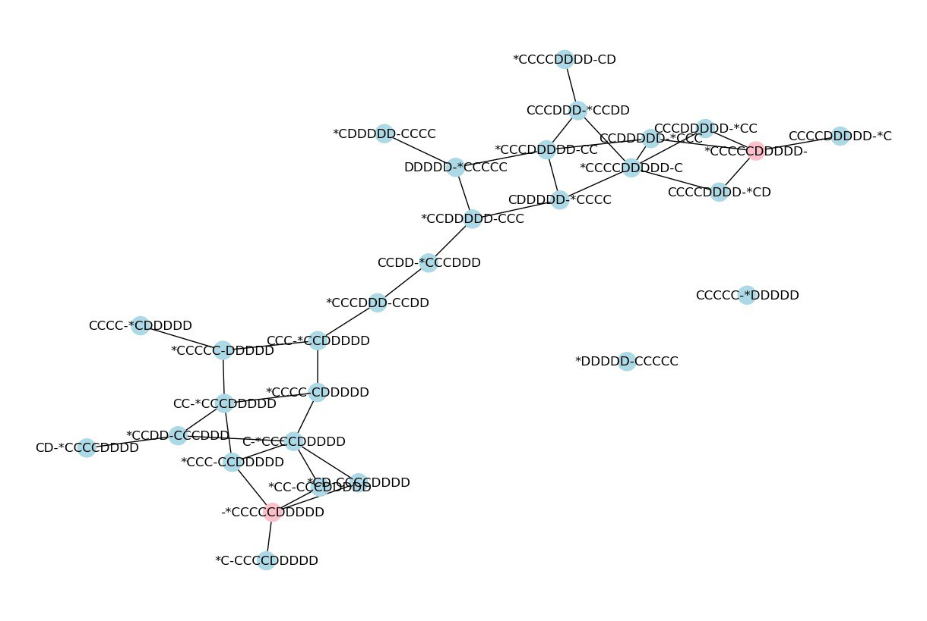
8 friends problem
10 friends problem

Slide 11
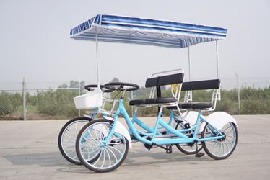
The final challenge

Slide 12
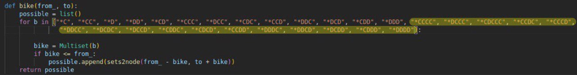
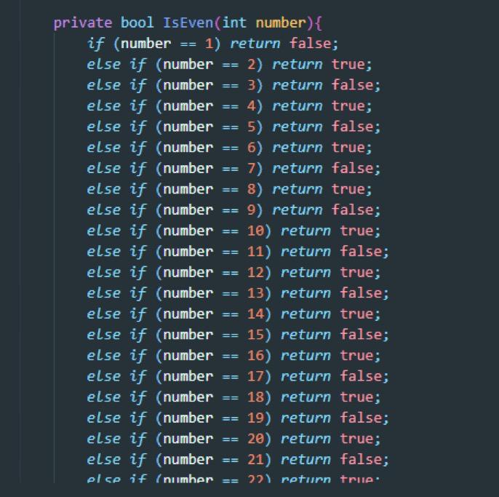
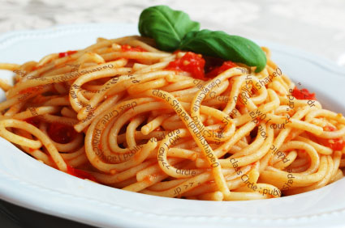
More fun with combinatorics ☺
Starting to feel like this guy

Slide 13
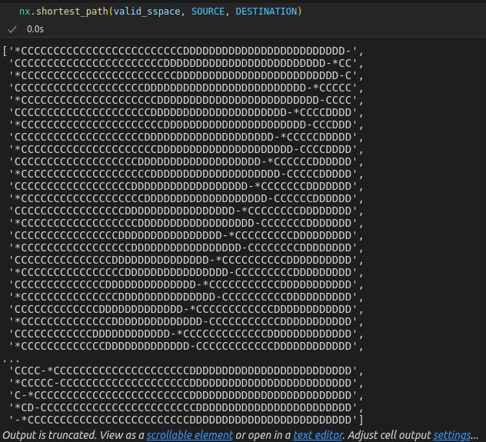
50 friends problem
4 seats bike has the solution for any number of friends since I can just take 4 people and go back with 2 and keep repeating the process until everyone is at the pub

Slide 14
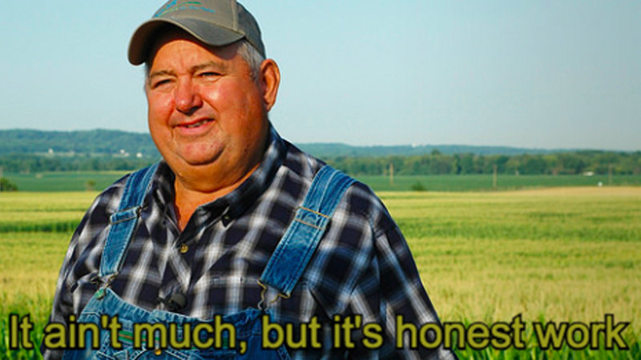
THE END

